Slide 1
MEDICAL MANAGEMENT of CROHN’S DISEASE in 2013
ATILLA ERTAN, MD, FACP, MACG, AGAF
Professor, University of Texas Health [UTH]
Ertan Digestive Disease Center & GI/Liver
Center of Excellence, UTH/MHPB-TMC

Slide 2
Disclamer
Grant/Research Support from AbbVie, UCB, Janssen, Santarus & Pfizer Pharmaceuticals, and Covident/Barrx Inc.
Scientific Advisory Board Member in AbbVie, Covident/Barrx and UCB Pharmaceuticals

Slide 3
Learning Objectives
To describe our therapeutic goals in CD.
To understand evidence on the efficacy, limitations and safety of available new agents in medical management of CD.
To summarize research on the creation of promising novel agents in treatment armamentarium of CD.

Slide 4
THERAPEUTIC GOALS IN CD
Clinical improvement
Clinical remission
Corticosteroid weaning
Maintenance of remission
Maintained tissue healing
Decrease in hospitalization & surgical interventions
Prevention of complications
Change natural course of the disease

Slide 5
HISTORY OF CD TREATMENT
1979 Sulfasalazine, steroids
1980 Antibiotics, Azathioprine, 6-MP
1993 5-ASA
1994 Budesonide
1995 Mtx
1998 Infliximab
2007 Second generation anti-TNF agents
2013 New agents

Slide 6
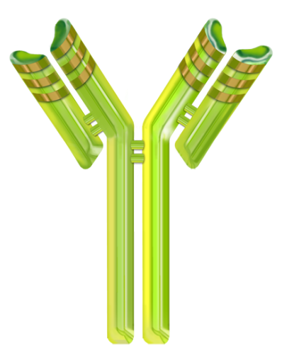
Biologic Agents
Chimeric monoclonal antibody
Human
monoclonal
antibody
Humanized Fab′ fragment
Humanized
monoclonal
antibody
_{Fc-free Fab’}
_{fragment}
Fc
IgG1
Fc
IgG1
Fc
IgG4
_{PEG} _{molecules}
Infliximab
(Anti-TNF)
Adalimumab
(Anti-TNF)
Certolizumab
pegol
(Anti-TNF)
Natalizumab
(Anti-α4 Integrin)
Notes:
Advantages of Pegylation
PEGylation extends the plasma half-life of certolizumab pegol to approximately 2 weeks (that of an intact mAb)¹
PEGylation improves bioavailability¹
PEGylation has been shown to enhance penetration and retention of macromolecules into various disease tissues^{1,2}
PEGylation has been shown to reduce immunogenicity in some proteins (at this time this has not been shown for certolizumab pegol)^{1,3}

Slide 7
AGA Consensus Panel on BT with Anti-TNF Agents in CD
 | Infliximab | Adalimumab | Certolizumab
Induction of response and remission | √ | √ | √
Maintenance of response and remission | √ | √ | √
Steroid sparing | √ | √
Fistulizing disease | √ | √ (perianal)
Severe disease; hospitalized patients | √
Extraintestinal manifestations | √
Loss of response or intolerance to infliximab |  | √ | √
Clark M et al. Gastroenterology. 2007;133(1):312

Slide 8
AGA Consensus Panel on BT : Dosing of Anti-TNF Agents
5 mg/kg IV at wk 0, 2, and 6
Primary nonresponse can be determined after 2 doses
Induction
Infliximab
Every 8 wk in responding patients
Attenuated response
Higher doses ≤10 mg/kg at 8-wk intervals
5 mg/kg at shortened intervals
Maintenance
160 mg SC on wk 0, followed by 80 mg SC on wk 2 and 40 mg on wk 4
Induction
Adalimumab
40 mg SC every other wk in responding patients
Suboptimal response
Increase frequency of dosing to 40 mg SC weekly or 80 mg every other week
Maintenance
400 mg SC at wk 0, 2, and 4
Induction
Certolizumab
400 mg SC every 4 wk in responding patients
Anticipate similar recommendations to other anti-TNFs regarding higher-dose/reduced-interval treatment
Maintenance
Clark M et al. Gastroenterology. 2007;133(1):312

Slide 9
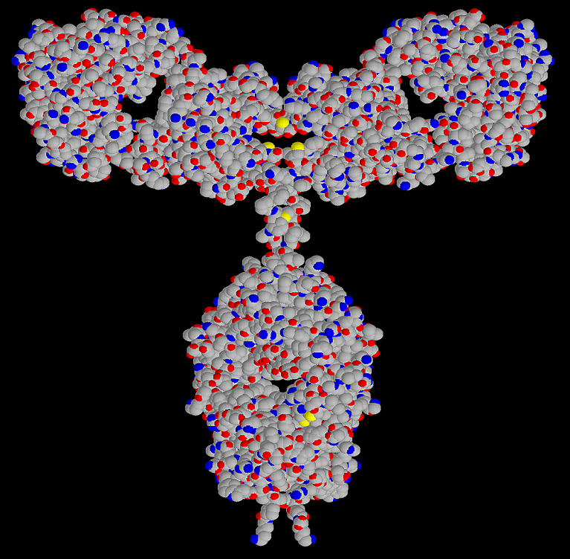
HUMIRA® (adalimumab)
Fully human monoclonal antibody (IgG₁) that specifically neutralizes TNF-α
Half-life of 12 to 14 days
Patient self-administered sc pen injection
CD: starting dose 160/80/40 mg week 0, week 2 & 4
Maintenance dose 40 mg eow week 4

Slide 10
Results at Week 4
CLASSIC I
Placebo/placebo
HUMIRA 40/20
HUMIRA 80/40
HUMIRA 160/80
70
*
†
*
55%
58%
‡
60
53%
50
49%
*
37%
40
36%
34%
32%
Subjects (%)
30
24%
24%
20
18%
12%
10
0
Clinical Remission
Response, Δ70
Response, Δ100
* p<0.05; † p=0.003; ‡ p=0.002
Clinical remission=CDAI<150
Clinical response Δ70 or Δ100=CDAI
decrease from baseline ≥70 or ≥100
Gastroenterology 130: 323, 2006
Notes:
Comments about references on slide:
Data in Hanauer SB, Gastro 2006 publication based on preliminary data of CLASSIC I. Data on slide is based on final data analysis of CLASSIC I and matches what is in HUMIRA package insert.

Slide 11
Complete Healing of Draining Fistulas at Last 2 Visits, Total Randomized Patients
CHARM
PBO
40 mg EOW
40 mg weekly
both HUMIRA groups
50
p= 0.016, combined HUMIRA groups vs placebo
40
37
33
30
30
Patients Completely Healed (%)
20
13
10
6/47
11/30
12/40
23/70
0
Healing = no draining fistulas for at least their last 2 post-baseline evaluations
Patients with fistulas: draining fistulas at both screening and baseline

Slide 12
Maintenance of Healing of Draining Fistulas: Weeks 26 and 56; All Randomized Patients
CHARM
PBO
40 mg EOW
40 mg weekly
both HUMIRA groups
50
p= 0.043
p= 0.043
40
33
33
28
30
28
30
30
Patients Completely Healed (%)
20
13
13
10
6/47
10/30
11/40
21/70
6/47
10/30
11/40
21/70
0
Week 26
Week 26 and 56
Healing = no draining fistulas
Patients with fistulas: draining fistulas at both screening and baseline
Gastroenterology 132: 52, 2007

Slide 13
CLASSIC II (M02-433)
Phase III Study of HUMIRA Maintenance of Remission in Anti-TNF Naïve Patients

Slide 14
Randomized Cohort: Clinical Remission (CDAI<150)
CLASSIC II
*
LOCF; ITT population, n=55
*p<0.05 versus placebo
Gut 98: 365, 2007

Slide 15
GAIN (M04-691)
Gauging Adalimumab Efficacy in Infliximab Non-Responders Phase III Study of HUMIRA Induction in Infliximab Failure Patients
Notes:
A Multi-Center, Randomized, Double-Blind, Placebo-Controlled Study of the Human Anti-TNF Monoclonal Antibody Adalimumab for the Induction of Clinical Remission in Subjects with Moderate to Severe Crohn's Disease who Have Lost Response or are Intolerant to Infliximab

Slide 16
Response Rate ≥70-Point CDAI Decrease (CR-70)
GAIN
†
†
52
52
*
% of Patients
35
34
33
21
Week
*p<0.005, †p<0.001, both vs. placebo.
Ann Intern Med 146: 829, 2007

Slide 17
Conclusions of the GAIN
HUMIRA was effective in inducing clinical remission and response in subjects with moderate to severe CD who had lost response or had adverse reactions to infliximab
Effect was observed as early as week 1
HUMIRA was well-tolerated with overall lower incidence of adverse events compared to placebo and with an AE profile similar to previous studies in CD and RA.
Notes:
W

Slide 18
Anti-TNF Agents – Overview
These agents have never been compared head-to-head. They are effective similarly in inducing CRM [30%] and CRS [50%] in pts with CD [combination with IM is better].
This BT was effective approximately 1/3 of CD patients with complete healing of draining fistula.
Pts with a successful induction d/c’ed steroids, maintained remission [60-80%] with significantly less complications, hospitalization and surgical interventions.
BT with these agents is the best option in young pts/young disease for altering the natural course of CD.
All agents have immunogenicity & carry serious AEs.

Slide 20
CLASSIC II
Immunogenicity data

Slide 21
Immunogenicity
CLASSIC II
7/269 patients (2.6%) were positive for AAAs
 | % AAA+
+ Immunosuppressants | 0%
- Immunosuppressants | 3.8%
3/7 AAA+ patients (43%) in remission at Week 24
2/7 AAA+ patients (29%) in remission at Week 56
Sandborn WJ, et al.: Gut , 98; 365, 2007

Slide 22
CHARM Safety Data

Slide 23
Adverse Events: All Exposure
Adverse events (AE), n=1459 | E (E/100-PYs)
Any AE | 12,124 (805.0)
Any serious AE | 487 (32.3)
Any AE leading to discontinuation | 326 (21.6)
Infectious AE | 2,146 (142.5)
Serious infections | 90 (6.0)
Malignant neoplasms | 17 (1.1)
Injection-site related AE | 552 (36.7)
Opportunistic infections | 32 (2.1)
Congestive heart failure (CHF) | 1 (<0.1)
Demyelinating disease | 2 (0.1)
Notes:
T1272

Slide 24
Overview of Opportunistic Infections: All Exposure
System organ class, n (%) | HUMIRA n=1459
Any AE | 29 (2.0)
Oral Candidiasis | 22 (1.5)
Esophageal Candidiasis | 4 (0.3)
Coccidioidomycosis | 1 (<0.1)
Nocardiosis | 1 (<0.1)
Tuberculosis | 3 (0.2)
Colombel JF, et al. Gastroenterology 2007; 132(4 Suppl 2)
Notes:
T1272

Slide 25
Lymphoma in Patients with CD
CD Publication | Relative incidence of lymphoma
Greenstein, 1985 | 4.7- fold increase
Mellemkjaer, 2000 | 1.5- fold increase
Lewis, 2001 | 1.4- fold increase
Bernstein, 2001 | 2.4- fold increase
Notes:
There is also evidence there is an increased risk of lymphoma in CD patients, especially those with more severe disease. Similar to RA, it is not clear whether this is due to the underlying disease itself or to the conventional immunomodulator medications these patients frequently take.
Greenstein et al: A retrospective review of the case records of 1227 Crohn’s disease patients admitted to The Mount Sinai Hospital between 1960 and 1982.
Mellemkjaer et al: A cohort study of 2645 patients who had been hospitalized with Crohn’s disease during 1977-1989 who were identified from the Danish National Registry of Patients in comparison with the incidence in the general population of Denmark. Cancer incidence for up to 17 years was determined in the cohort and compared to an expected number derived from national cancer incidence rates.
Lewis et al:A population based retrospective study was conducted in IBD patients (n=6605, CD; n=10,391, UC; n=67,970, controls) to determine the risk of lymphoma within the United Kingdom. Patients were followed for an average of 3.7, 3.9, 4.4 years, respectively.
Bernstein et al: A population based matched cohort design of 2857 crohn’s disease patients with 21,340 person-years of observation for 1984-1997. Site specific cancer incidence rates in a cohort of persons with IBD were compared with those of non-IBD cohort that matched (1:10) to the IBD cohort based on age, gender, and geographic location of residence. The population based data was gathered from the administration claims data of Manitoba universal provincial insurance plan.

Slide 26
NON-HODGKIN’S LYMPHOMA IN CD
Event Estimated Frequency(annual)
Baseline 0.02% (2/10.000)
On IM* 0.04% (4/10.000)
On anti-TNF** 0.06% (6/10.000)
* IM = Immunomodulators
**TNF= Tumor necrosis factor
In: Targan S, Shanahan F, Karp L, eds. IBD. Translating basic science into clinical practice. In press, 2013.

Slide 27
Hepatosplenic T-cell Lymphoma
16 reported/possible cases
All were reported between 2002 and September 2009
13 cases with inflix./3 with adalimumab and AZA/6-MP
All cases reported to be HSTCL had IBD.
Ages: 12, 15, 17, 18, 19 (3 pts), 21, 22, 22, 29, 31, 31, 40, 58
14 with CD, 1 UC, 1 indeterminate colitis with features of UC
11 cases from US, 2 cases from Germany, 1 case each from UK, Norway and Australia
15/16 males
Range infliximab infusions: 1 to 24
7 had limited infliximab exposure (1-3 infusions)
Notes:
The need to consider the issue of hepatosplenic T-cell lymphoma when weighing the benefits and risks of infliximab monotherapy versus combination therapy with azathioprine has recently arisen.
While no cases have been reported from patients in the SONIC trial, to date, there have been 16 reported or possible cases of hepatosplenic T-cell lymphoma, all in patients with inflammatory bowel disease. All were reported between 2002 and September 2008. All patients were receiving both infliximab and either azathioprine or 6-MP. Three cases involved adalimumab treatment.
Ages of patients ranged in age from 12 to 58 years. 13 patients had Crohn’s disease, 1 had ulcerative colitis, and 1 had indeterminate colitis with features of ulcerative colitis.
There were 10 cases from the United States, 2 cases from Germany and 1 case each from the United Kingdom, Norway, and Australia.
14 of the 15 reported patients were males.
The number of infliximab infusions received by these patients ranged from 1 to 24, with 7 of the patients having only limited exposure of 1 to 3 infusions.

Slide 28
Malignancy with BT
At the present time, it is not possible to be certain whether the BT increases a patient’s chance of developing a malignancy
There is also concern that BT with conventional immunomodulators may increase the risk of malignancy
Risks must always be weighed against the risks of inadequate treatment of the underlying disease
Caution should be exercised when treating any patient with a current or past history of malignancy
Notes:
Concerns about the potentially-increased risk of lymphoma and other malignancies with the use of infliximab must be considered in a number of contexts. However, even if an added risk exists, it has to be considered in the context of the benefit patients derive from these drugs. It must be borne in mind that the appropriate candidates for infliximab therapy in IBD already have a serious disease that has inadequately responded to conventional therapy. There are serious consequences of inadequately-treated IBD and these must be appropriately weighed against the concerns about malignancy.

Slide 29
Pregnancy & BT
BT can be continued during conception,
pregnancy and lactation.
Negative impact to mother or baby is low.
If mother remains in remission, Infliximab
& Adalimumab could be d/c’ed in the 3rd
trimester and restart after the delivery.
Certolizumab may be safe throughout pregnancy.
BT appears to be safe during breastfeeding.
BT agents are detected in infants for 6 months.
Practical Gastroenterol 63: 33, 2010.
Expert Rev Clin Immonol 9: 161,2013.

Slide 30
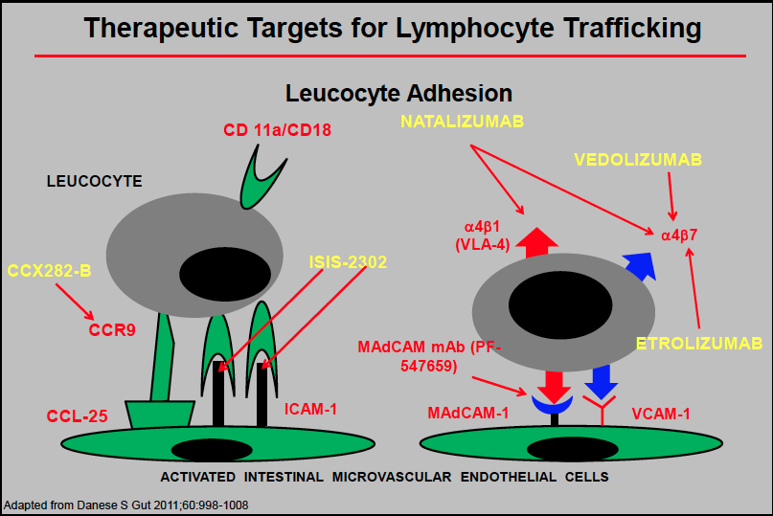

Slide 31
NATALIZUMAB [Tysabri]
This Integrin alfa-4b7 inhibitor is an effective agent as BT with TNF-Abs as a monotherapy, 300 mg IV Q4 weeks through the TOUCH program.
Progressive Multifocal Leukoencephalopathy [PML] is a deadly AE by JC virus and need close monitoring in addition to its other AEs.
It is indicated in pts with CD to refractory or intolerant with TNF-alfa MCA.
Gastroenterology 132: 1672, 2007 & NEJM 368: 2240, 2013

Slide 33
VEDOLIZUMAB
It is a humanized GI-selective MCA directed against alfa4beta7 integrin that blocks specifically gut homing lymphocyte trafficking.
The CRM was 14.5% vs. 6.8% with placebo (p=0.02) at wk 6. In another study, the CRS 39% vs. 21.6% with placebo (p<0.001) in pts with CD.
It is expected to have no PML. Four deaths occurred ; causes were sepsis x 2, suicide and myocarditis.
NEJM 369: 711-21 & 775-6, 2013

Slide 34
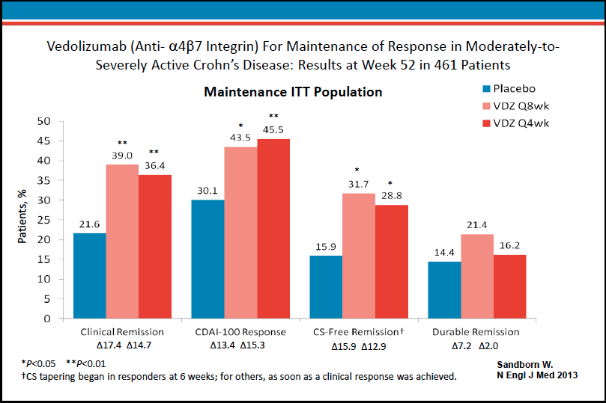

Slide 35
THERAPEUTIC GOALS IN CD
Clinical improvement
Clinical remission
Corticosteroid weaning
Maintenance of remission
Maintained tissue healing
Decrease in hospitalization & surgical interventions
Prevention of complications
Change natural course of the disease

Slide 36
New Agents in Development for the Treatment of CD
Golimumab TNF-alfa ab Humanized MCA
Vedolizumab Anti-alfa4beta7 GI specif. integrin ab
Etrolizumab Anti-beta7 GI specif. integrin ab
Ustekinumab Anti-IL-12/23p40 Humanized MCA
Tofacitinib* Anti-Janus kinase3 Immunomodulator
Secukinumab Anti-IL17 Humanized MCA
Atlizumab Anti-IL-6 Humanized MCA
Vercirnon* Anti-chemokine9 T cell CCR9 rec. ab
MMPL-004* Herbal mixture Antiinflammatory
Fingolimod* Sphingosine1PR1 Lymph. rec. agonist
* PO agents
*

Slide 37
GOLIMUMAB [Simponi]
It is new humanized TNF-alfa MCA that is approved by the FDA in pts with refractory CUC in early’13; also in RA, AS & PsA.
This is 200 mg SC injected at wk 0, followed by 100 mg at wk 2 then 100 mg Q4 wks with similar effectiveness & AEs in pts with CUC*.
Research with this BT agent is pending in pts with CD.
Gastroenterology, 2014 (in press)

Slide 40
USTEKINUMAB [Stelara]
It is a fully human IgG1 MCA against IL-12& IL-23 that is currently approved for pts with psoriasis.
336 pts with moderate-to-severe refractory CD responded as an induction therapy to SC 90 mg of Ustekinumab with 42% CRM vs. 27% of pts on placebo at week 22.
No deaths, serious opportunistic infections, tbc or significant CV AEs were reported.
NEJM 367:1519-28, 2012

Slide 42
TOFACITINIB [Xeljanz]
It is a oral agent that inhibits Janus kinase -1,-2 & -3; modulates signaling IL-2,-4,-7,-9,-15 &-21.
It is approved for pts with RA. Preliminary studies in CUC pts showed significant effectivenes in high doses (10 to 15 mg BID), but pts with CD did not respond well to tofacitinib.
AEs are infections, neutropenia, anemia, hyperlipidemia, transient transaminase & creatinine elevations.
NEJM 367:616-24, 2012 & DDW Abst.#745, 2013

Slide 43
Conclusions
BT was generally safe and well-tolerated in treatment of some of the patients with CD.
The safety profile & immunogenicity issues of BT are well studied.
New BT agents development is progressively evolving in treatment of patients with CD.
Notes:
T1272
Is BASDAI also a component of ASAS 20? Should the last two bullets be combined? When were ASAS 50, ASAS70, BASDAI 20, BASDAI 50 and BASDAI 70 considered major secondary factors?

